Slide 1

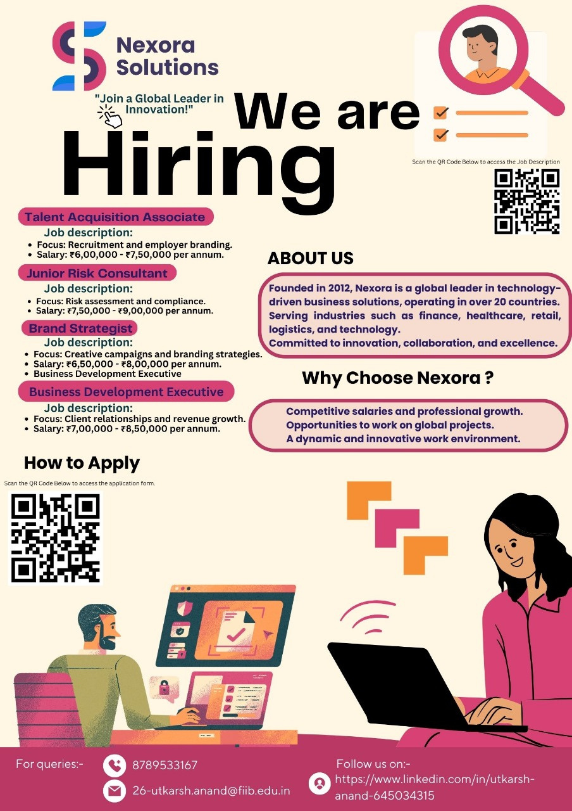
Nexora Solutions
RECRUITMENT CAMPAIGN

Slide 2

TABLE OF CONTENT
01
04
About Us
Hiring Process
02
05
Circulated Data
Statistics
03
06
Roles Offered Profile
Analysis of the application

Slide 3
ABOUT US
GET TO KNOW US BETTER
Nexora Solutions is a global company established in 2012, specializing in technology-driven business solutions. Headquartered in Gurugram, India, Nexora operates across 20+ countries, helping businesses improve efficiency and achieve their goals.
What We Do:
Technology Services: Building software and tools to simplify business operations.
Talent Solutions: Helping companies hire and manage the best talent.
Business Growth Support: Guiding businesses in expanding and reaching new markets.

Slide 4
CIRCULATED DATA
Link of application form: https://forms.gle/hvpXLgksPrWS2tCM9

Slide 5
ROLES OFFERED PROFILE
Department | Position | Vacancy | Location | Required Skills | Status
Risk Management | Junior Risk Consultant | 2 | Gurugram, India | Analytical skills, Problem-solving, Attention to detail, Basic understanding of risk management | Screening
Marketing | Brand Strategist | 1 | Remote | Creativity, Market research, Communication, Digital marketing basics | Screening
Human Resources | Talent Acquisition Associate | 3 | Gurugram, India | Communication, Organization, Networking, Understanding of recruitment processes | Screening
Sales | Business Development Executive | 4 | Remote / Gurugram | Sales skills, Communication, Negotiation, Customer relationship management | Screening

Slide 6
HIRING PROCESS
Step | Description
1. Application Submission | Candidates submit their applications and resumes.
2. Initial Screening | HR team reviews resumes to shortlist candidates based on qualifications, skills, and experience.
3. Online Assessment (if applicable) | Some roles may require online tests to assess basic skills like analytical thinking, communication, or technical knowledge.
4. Interview Round 1 | Shortlisted candidates are invited for a first round of interviews, typically conducted by HR. Focus on cultural fit, communication, and motivation.
5. Interview Round 2 | Final round with the hiring manager or department head. Focuses on specific role-related skills and problem-solving abilities.
6. Offer & Negotiation | Selected candidates receive a job offer. Salary and benefits are discussed and finalized.
7. Onboarding | Once candidates accept the offer, they go through the onboarding process, including orientation and training.

Slide 7
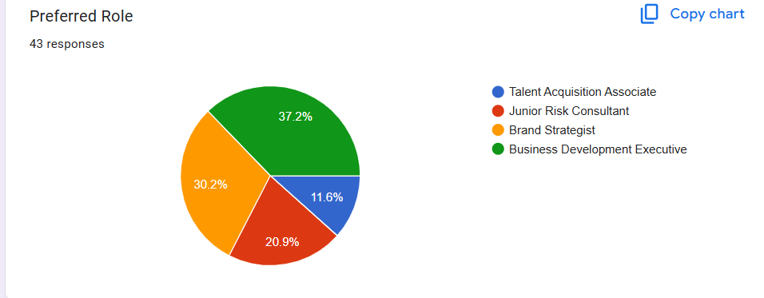
STATISTIC
ROLES PREFERRED
37.2% | People Preferred the role of Business Development Executive.
30.2% | People Preferred the role of Brand Strategist.

Slide 8
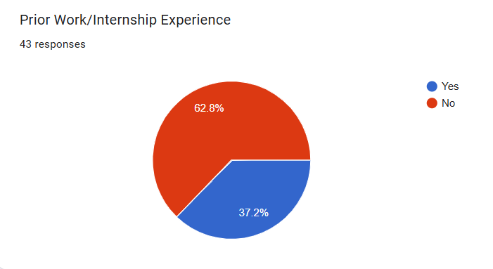
STATISTIC
PRIOR WORK EXPERIENCE
62.8% | Most of the people don’t have prior work experience in the applied field.
37.2% | People have prior working experience but not necessary in same field.

Slide 9

ANALYSIS OF THE APPLICATIONS
JUNIOR RISK CONSULTANT (RC)
Out of 9 relevant candidates, 3 have prior work experience.
Strong pool of qualified candidates with a significant portion having relevant experience.
BRAND STRATEGIST (BS)
10 out of 13 candidates are relevant for the role, with 2 candidates having prior work experience.
Good match of qualifications, though some candidates lack experience.

Slide 10
TALENT ACQUISITION ASSOCIATE (TA)
4 out of 5 candidates are relevant, with 2 having prior work experience.
Very high relevance with a good portion having work experience in recruitment.
BUSINESS DEVELOPMENT EXECUTIVE (BDE)
13 out of 16 candidates are relevant, and 4 have prior work experience.
Strong pool with high relevance, and several candidates bring valuable work experience.

Slide 11
THANK YOU

